Slide 1
COURSERA CAPSTONE: OPENING A GYM IN BARCELONA
INTRODUCTION
BUSINESS PORBLEM
DATA
METHODOLOGY
RESULTS
DISCUSSION
CONCLUSION

Slide 2
BUSINESS PROBLEM
The process of selection of a place to start a new business is always a key aspect for the correct development of it.
To do so, various factors are to be considered, being the existing competence one of the most important (if not the most).
The objective of this project is to go through this process, having focused on the gym industry. This business problem is of big relevance nowadays because of the current isolation situation in Barcelona, Spain, where our research is going to be done.
Throughout the use of Data Science, paired with Machine Learning algorithms (such as K-means clustering), the different suburbs in the city will be classified according to the amount of gyms they have or do not have. By doing so, it will be determined if opening a gym is a good opportunity as a whole, and if so, what are the best suburbs to do so in Barcelona

Slide 3
DATA
The steps followed to obtain he necessary information to start our evaluation were the following:
1. Extract the info about the neighborhoods of Barcelona using the following website and Beautiful Soup library for website scraping : https://en.wikipedia.org/wiki/Districts_of_Barcelona
2. Use pandas to obtain a datafram from this data
3. Use GeoPy Python package to obtain latitude and longitude of all the neighborhoods of Barcelona
4. Map the neighborhoods using Folium Python library
5. Use Foursquare API to get information about some venues around these neighborhoods

Slide 4
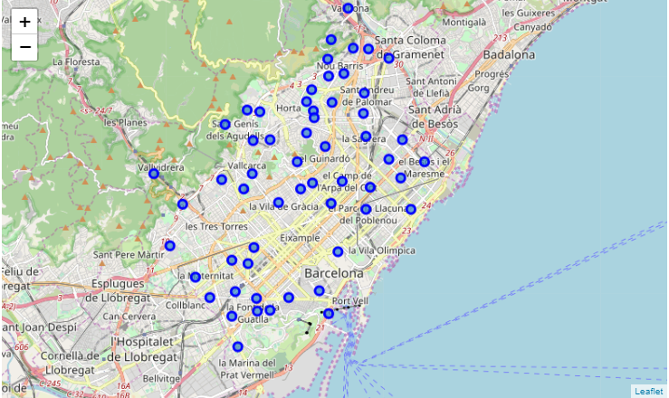
Neighborhoods of Barcelona

Slide 5
METHODOLOGY
In an attempt to find a solution to the proposed business problema, the following steps were followed:
Study the frequency of different kind of venues in the city, in order to see if gyms are very exploited or not as a whole
Obtain relative frequency of gym appearance per neighborhood
Using k-means clustering, the neighborhoods were divided into three groups, according to that frequency.
Select the neighborhoods within the cluster with less gym appearance

Slide 6
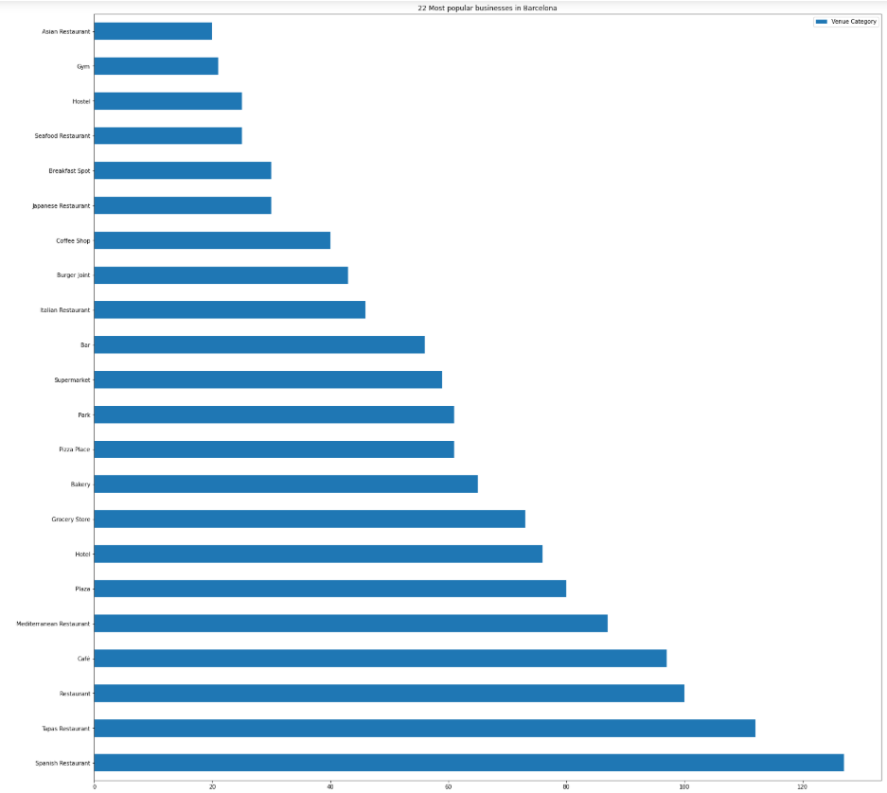
Gyms placed 22nd in the list of most popular kind of venues

Slide 7
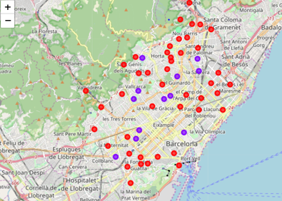
Map showing the three different clusters

Slide 8
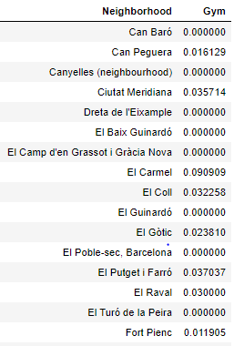
RESULTS
The results were surprisingly positive towards our hypothesis, as only of the neighborhoods were included into the group with many gyms, whereas the rest were divided between having little number of gyms or being in between.
This means that as a whole, the industry of gyms in Barcelona is yet to be exploited, which is great for our people of interest. (It can be seen by the graph, where 15 sample neighborhoods were introduced into a table with their relative gym frequency. It is clear that they are really small).
Knowing this, it is obvious that anyone interested in opening a new business would rather do it somewhere with less competence.
This group would correspond to our red cluster, which is indeed the most populated one.

Slide 9

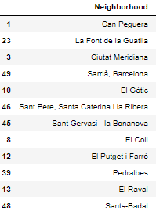
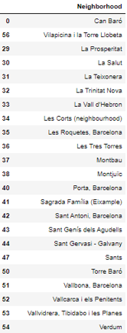
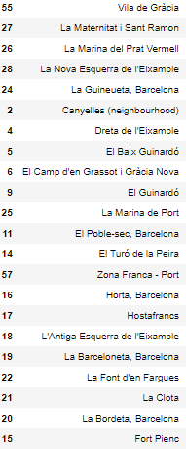
DISCUSSION
FIRST, SECOND AND THIRD CLUSTERS (FROM LEFT TO RIGHT)

Slide 10
Having acknowledged that the neighborhoods from the third cluster have less relative frequency of gyms, it would be a wise decision for the possible gym owner/creator to start his business in any of the 44 neighborhoods belonging to that cluster.
However, having such a wide range of options to choose from, it would possibly be convenient to follow with this research in the future, taking into account other variables like population per neighborhood, mean age, sex… which can all influence the probability of success of opening a gym and making it work properly.

